Slide 1
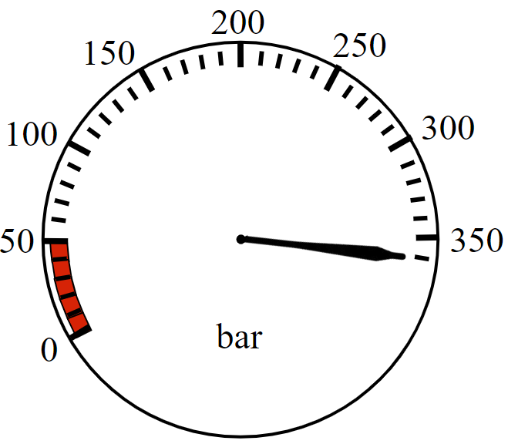
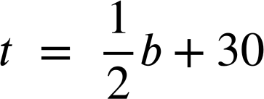
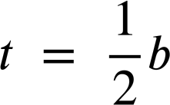
Emergency response worker
Task A: Uses of formulas
1) a) A firefighter enters the building with their gauge reading like so. At what bar should they turn around and start exiting?
b) A firefighter has an estimated turn-around pressure of 160 bar. How many bar of pressure did they have when they entered?
c) What is the difference in turn-around pressures between entering with 240 bar and entering with 300 bar?
d) Why do you think the formula includes + 30 instead of just being ?

Slide 2



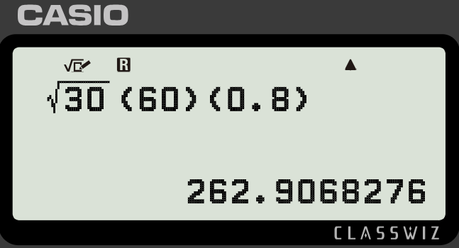

Emergency response worker
2) a) You are a police officer investigating an accident. Use the formula to calculate the speed of this car on a dry concrete surface (f = 0.8)
197 feet
b) If a car were travelling 70 mph on a wet concrete surface (f = 0.4) how long would you expect the skid mark to be?
c) Lucas has used the formula incorrectly to calculate the speed of a car with a skid mark of 60 feet on a dry concrete surface (f = 0.8). Explain his error to him and correct his work.
My calculator tells me their speed was 262.9 mph
d) A police officer investigating an accident in a 20 mph zone with a dry concrete surface (f = 0.8) declares, “The length of the marks were 20 feet to the nearest 10 feet”.
Explain why they cannot round like this when investigating this accident.

Slide 3
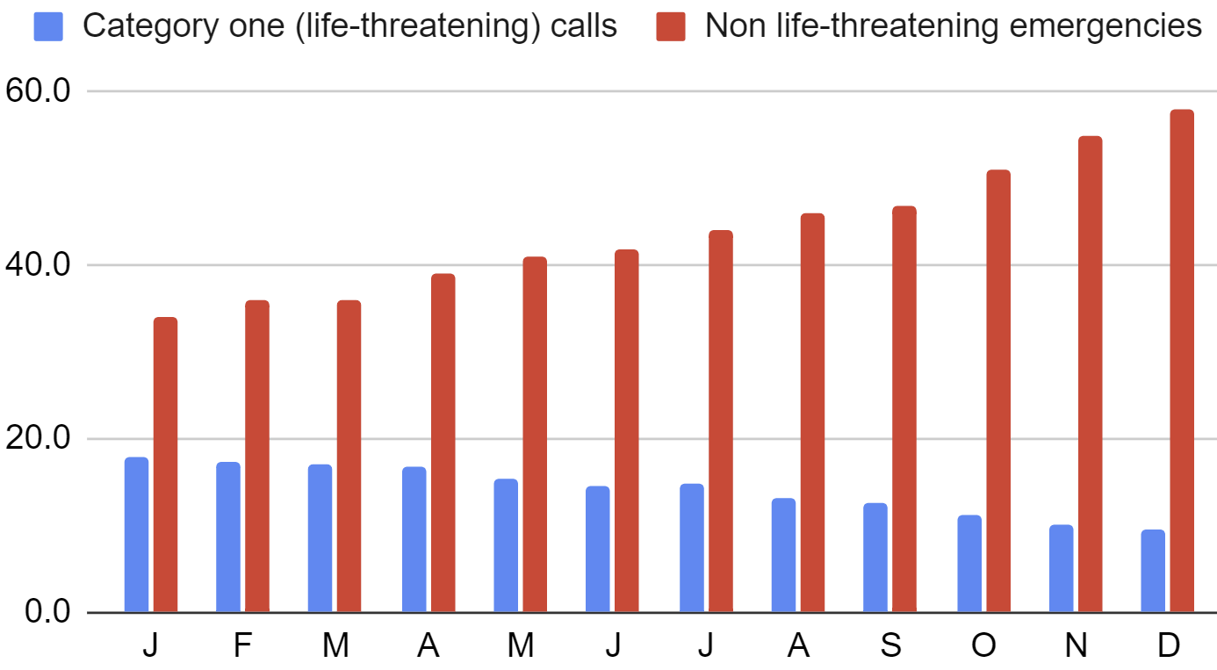
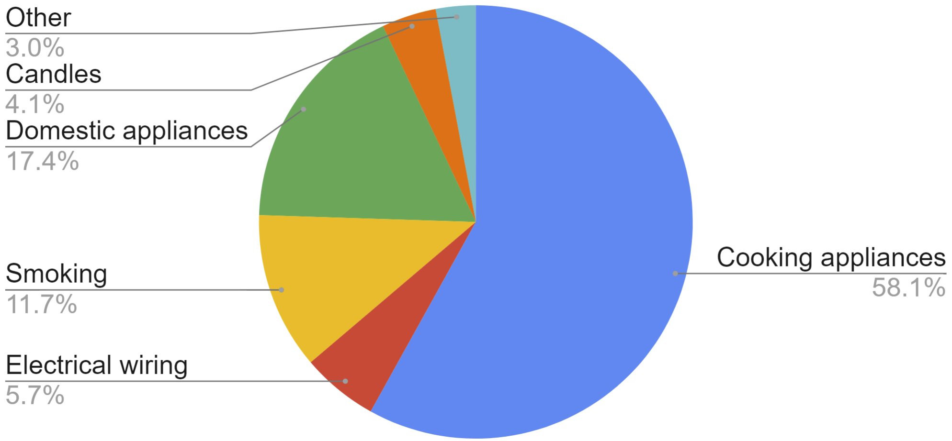
Emergency response worker
Task B: Uses of data
1) An ambulance station records their average response times to emergency calls one year. What patterns do you see in this data?
2) A regional fire service records the reasons for house fires over a year and produces this chart. What advice would you give this fire service? Write at least three sentences.
Mathematics in Education and Industry
v2.4

